Slide 1

Smart Campus Portal
A Unified Platform for Modern Educational Institutions
Presented by:
NS
by Nitesh Sharma

Slide 2
Addressing Campus Challenges
Problem Statement
Proposed Solution
Fragmented communication
Unified role-based portal
Manual processes for key tasks
Automated workflows
Lack of centralized data
Real-time data access

Slide 3





Core Features: Enhancing Campus Operations
Role-Based Access
Student Profiles
Assignment Tracking
Tailored views for students, teachers, and admins.
All academic data in one place.
Submit, grade, and monitor assignments.
Attendance Management
Efficiently record and view attendance.

Slide 4
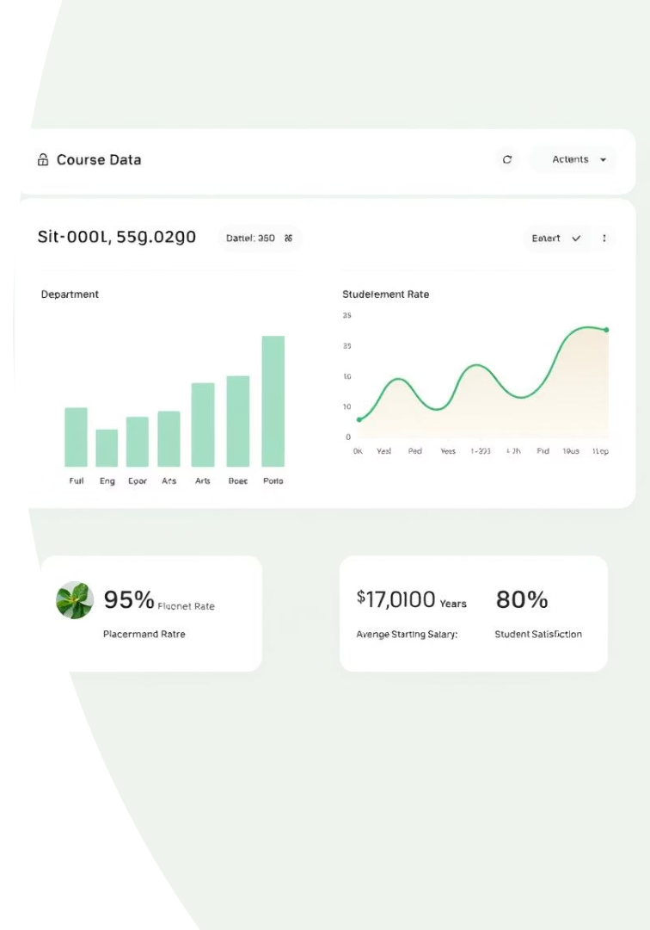
Advanced Modules: Expanding Functionality
1
Course Management
Organize and access all course materials.
2
Placement Module
Connect students with career opportunities.
3
Admin Control Panel
Full data control (CRUD operations).
4
Notices and Events
Real-time notifications for campus updates.

Slide 5
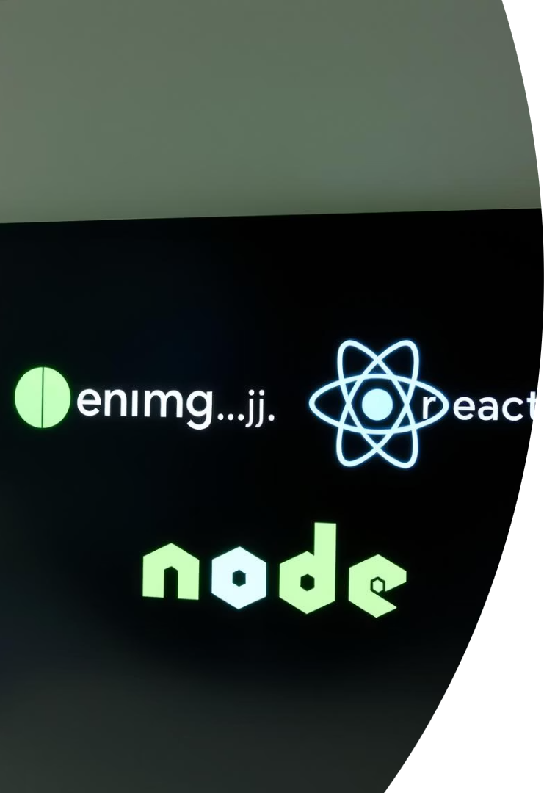



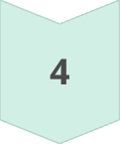
Robust Architecture: The MERN Stack
React.js
Dynamic user interfaces
Node.js/Express.js
Scalable backend APIs
MongoDB
Flexible NoSQL database
JWT
Secure authentication
Our system is built on the robust MERN stack, ensuring high performance and scalability. React.js powers the interactive frontend, while Node.js and Express.js provide a powerful RESTful API. MongoDB offers a flexible and efficient database solution, with JSON Web Tokens (JWT) securing all user authentication.

Slide 6

Project Structure: Modular and Scalable
smart_campus/├── client/ # React frontend├── server/ # Express backend├── .env # Environment config
The project is designed with a clear, modular structure. Reusable components enhance development efficiency, while protected routes ensure data security. REST APIs facilitate seamless communication between the client and server. This clean architecture supports easy scalability and maintenance.

Slide 7
Live Demonstration: See It in Action
Witness the portal's features firsthand:
Login as student, teacher, and admin.
Navigate through dashboards.
Explore assignments, notices, and placements.
Demo Video Link

Slide 8



Getting Started: Setup Instructions
Clone and Install
Get repo, install dependencies.
Configure .env
Set MONGO_URI, JWT_SECRET.
Run Servers
Start backend (5000), frontend (3000).
Admin Credentials: ID - nitesh | Password - nitesh

Slide 9
Future Vision & Key Learnings
Future Scope
Challenges & Learnings
QR-based attendance
Role-based security
AI recommendation engine
Token authentication
Placement prediction models
Real-time UI feedback
Alumni/Parent portals
Modular code principles

Slide 10

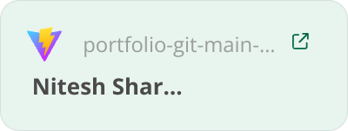
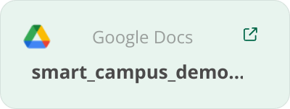
Thank You
1
2
3
4
Questions
Contact
Contact
Demo Video
Ask away!
niteshsharmans775@gmail.com

